Slide 1
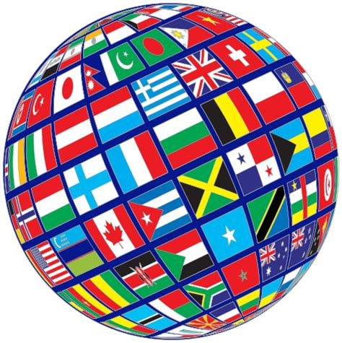
Celebrating Differences

Slide 2
DIVERSITY
Guess the word
Definition:
The fact of there being many different people, groups or opinions in society.
These may include religions; ethnicities; likes and dislikes which help to make up our identities.

Slide 3
London - How diverse are we?
London is extremely diverse. Below are a few
statistics that represent people living in London
Population: 8.825 million
Nations represented: 270
Languages: 300

Slide 4
Religion – How diverse are we?
Londoners practice various religions
Christianity (48.4%)
Not religious (20.7%)
Islam (12.4%)
Hinduism (5%)
Judaism (1.8%)
Sikhism (1.5%)
Buddhism (1%)
Other religions (0.6%)

Slide 5
Sports – How diverse are we?
People in London support different teams. There
are 7 London teams in the Premier League
Arsenal
Chelsea
Crystal Palace
Fulham
Tottenham Hotspur
Watford
West Ham

Slide 6
My Identity Crest

Slide 7
Your task
Design your own identity crest on an A4 page (as on the previous slide)
Draw and colour 4 symbols that represent how diverse you are
These may include:
Nationality
Religion
Ethnicity
Football Club
Or any other ways that make you who you are

